Slide 1
TAKE OUR JOBS MIXER
Rector Elections
Welcome to the Rector Elections Information Session
AMS Executive

Slide 2
Information Night Agenda
Contact Information
Overview of the elections process
Important Dates
Prepare for nomination and campaigning

Slide 3
Who is the CEO?
Chief Electoral Officer; works under the Secretariat
Responsible for Elections
Ballots, Candidates, Clarifications, Complaints, Debates, Voting
Key point of contact during the elections process

Slide 4
Contact Information
Calder Bryson, CEO: ceo@ams.queensu.ca , 604-652-7161
Alysha Ahmad, Secretariat: secretariat@ams.queensu.ca
Katie Zutautas, SGPS Deputy Speaker: deputy.speaker@sgps.ca

Slide 5
Event Purpose
Meet with past Rectors Owen and Cam
Ask questions
Gain an understanding of Elections Process
Meet with CEO

Slide 6
Nomination Period
JANUARY 14th – JANUARY 18th
Collect signatures from 1% of AMS AND SGPS fee paying members – 281 signatures
NOT an opportunity to campaign

Slide 7
Validation at Assembly
JANUARY 23rd at 6:00 PM
Candidates who have successfully collected signatures are ratified at AMS Assembly

Slide 8
Campaign Period
JANUARY 29th – FEBRUARY 5th
Campaigning may NOT begin before this time
Publicize and promote your campaign
Engage with students

Slide 9
Campaign Period Rules
Candidates are allotted $400
Re-imbursement forms due 5pm on February 7th
Giveaways, raffles, other prizes not permitted
All materials must be approved by the Elections Team
Endorsements and Mass Emails
Not permitted from AMS Assembly Voting Members, AMS Execs, or FacSoc Execs
Club Endorsements allowed

Slide 10
Rector Candidates Debate
JANUARY 30th
Introduce yourself and your platform
Platforms released 24 hours before debate
Blended Format
Respond to various questions

Slide 11
VOTING DAYS
FEBRUARY 6th – FEBRUARY 7th [ 8:00 PM ]
*Online campaigning allowed
Results released night of February 7th

Slide 12
DISPUTES
All disputes or complaints regarding the violation of AMS elections policy shall be submitted in the manner determined by the Elections Team
All complaints must include:
The candidates or team involved in the violation
Reference of the election policy which they are in violation of
Sanctions: warnings, financial penalties, social media limits and disqualification.
Submit an Elections Policy Complaint Form (found in the nomination package) ceo@ams.queensu.ca

Slide 13
Questions?
Next up, the Rectors.

Slide 14
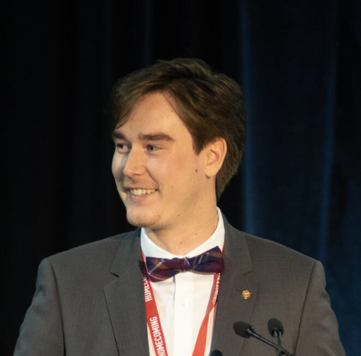
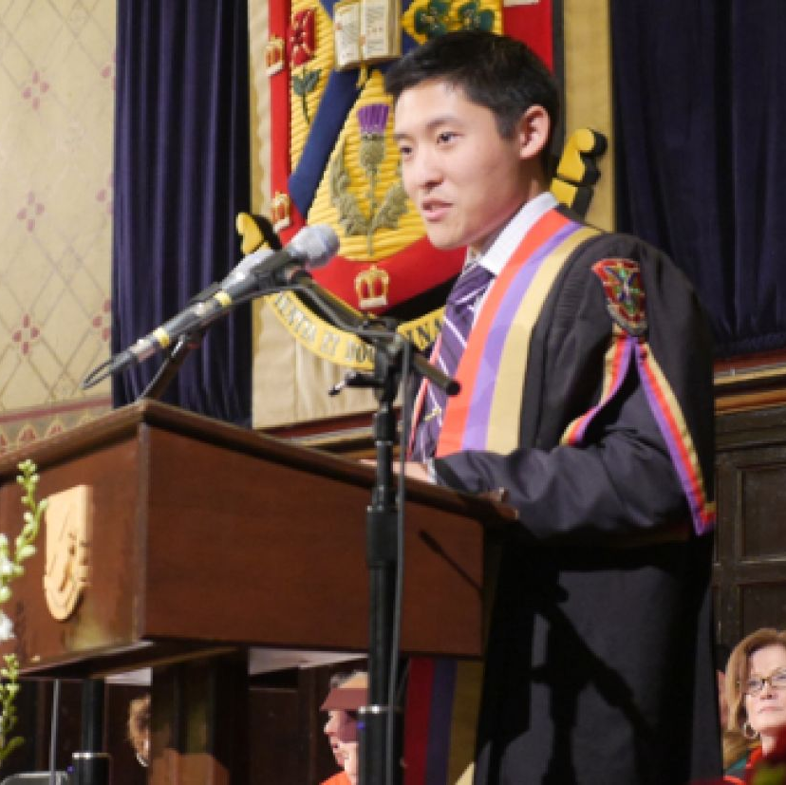
Previous Rector
Owen Crawford-Lem
38th Rector
Cam Yung
35th Rector

Slide 15
Contact Information
Owen Crawford-Lem, Rector: rector@queensu.ca

